Slide 1
Breaking Illusions with Testing
Maaret Pyhäjärvi

Slide 2
A Few Years Ago…
But not in a galaxy far far away. ☺

Slide 3


Slide 4
She's like "I want to exploratory test your ApprovalTests" and I'm like "Yeah, go for it", cause it's all written test first and its code I'm very proud of. And she destroyed it in like an hour and a half.
http://visible-quality.blogspot.fi/2017/03/from-appreciation-of-shallow-testing.html
Notes:
When I go into a product as an exploratory tester, these kind of experiences happen. This is a statement from a programmer, given in one podcast quite voluntarily without me leading them into it.
I took a look at his open source project, and asked that I want to do some testing on it for purposes of a conference I wanted to do an exploratory API testing session on. They said go for it, you won’t fin d anything. It’s unit tested and all that.
End conclusion was that I totally destroyed it in an hour and a half. But the thing I really destroyed was not the app I was testing, just his ideas and illusions he was holding on how excellent it was. He had things his unit tests were looking for, but that still left open many other kinds of problems. They had ideas of what the system did, had high level promises of what value it would provide, how consistent things would be and many of those things failed.

Slide 5
Testers don’t break the code, they break your illusions about the code.
- Adapted from James Bach
Notes:
I’m not actually finding bugs. I’m finding things where people’s beliefs are off.
When I go and use somebody else’s application, I don’t do that so that I would find bugs or break the software. I don’t intend to leave the software broken.
It was actually already broken before I got there. I just told folks about it.
You know, I’m not the one who is going to be there fixing it in the middle of the night if it broke in production in a really bad way. That’s usually the dev who introduced the problems there in the first place.
But I do have a habit of breaking those illusions. And this talk is centered around those illusions, helping you maybe to work on those as well.

Slide 6
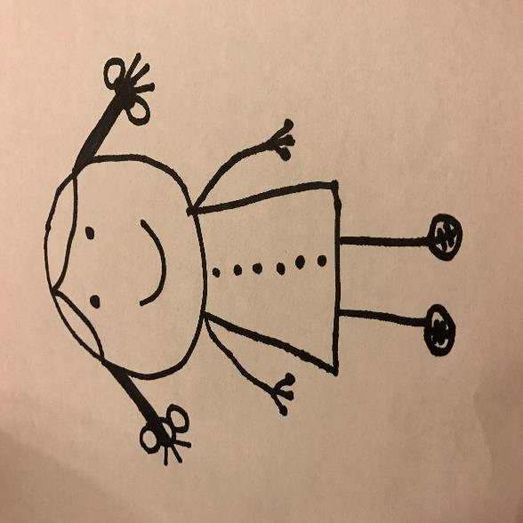
Notes:
All possible illusions – not just ones “tester” would gravitate towards with the boxes organizations draw around testers.

Slide 7
Basic Illusions: Code Making a Product
Code doing what it’s supposed to.
Product doing what it would need to.
Product doing only what it is supposed to do.
Other Illusions: Ideas Leading to Code
Process being able to deliver with a change in mind
People having skills to deliver well.
Business model driving the selection of right focus.

Slide 8
How?

Slide 9
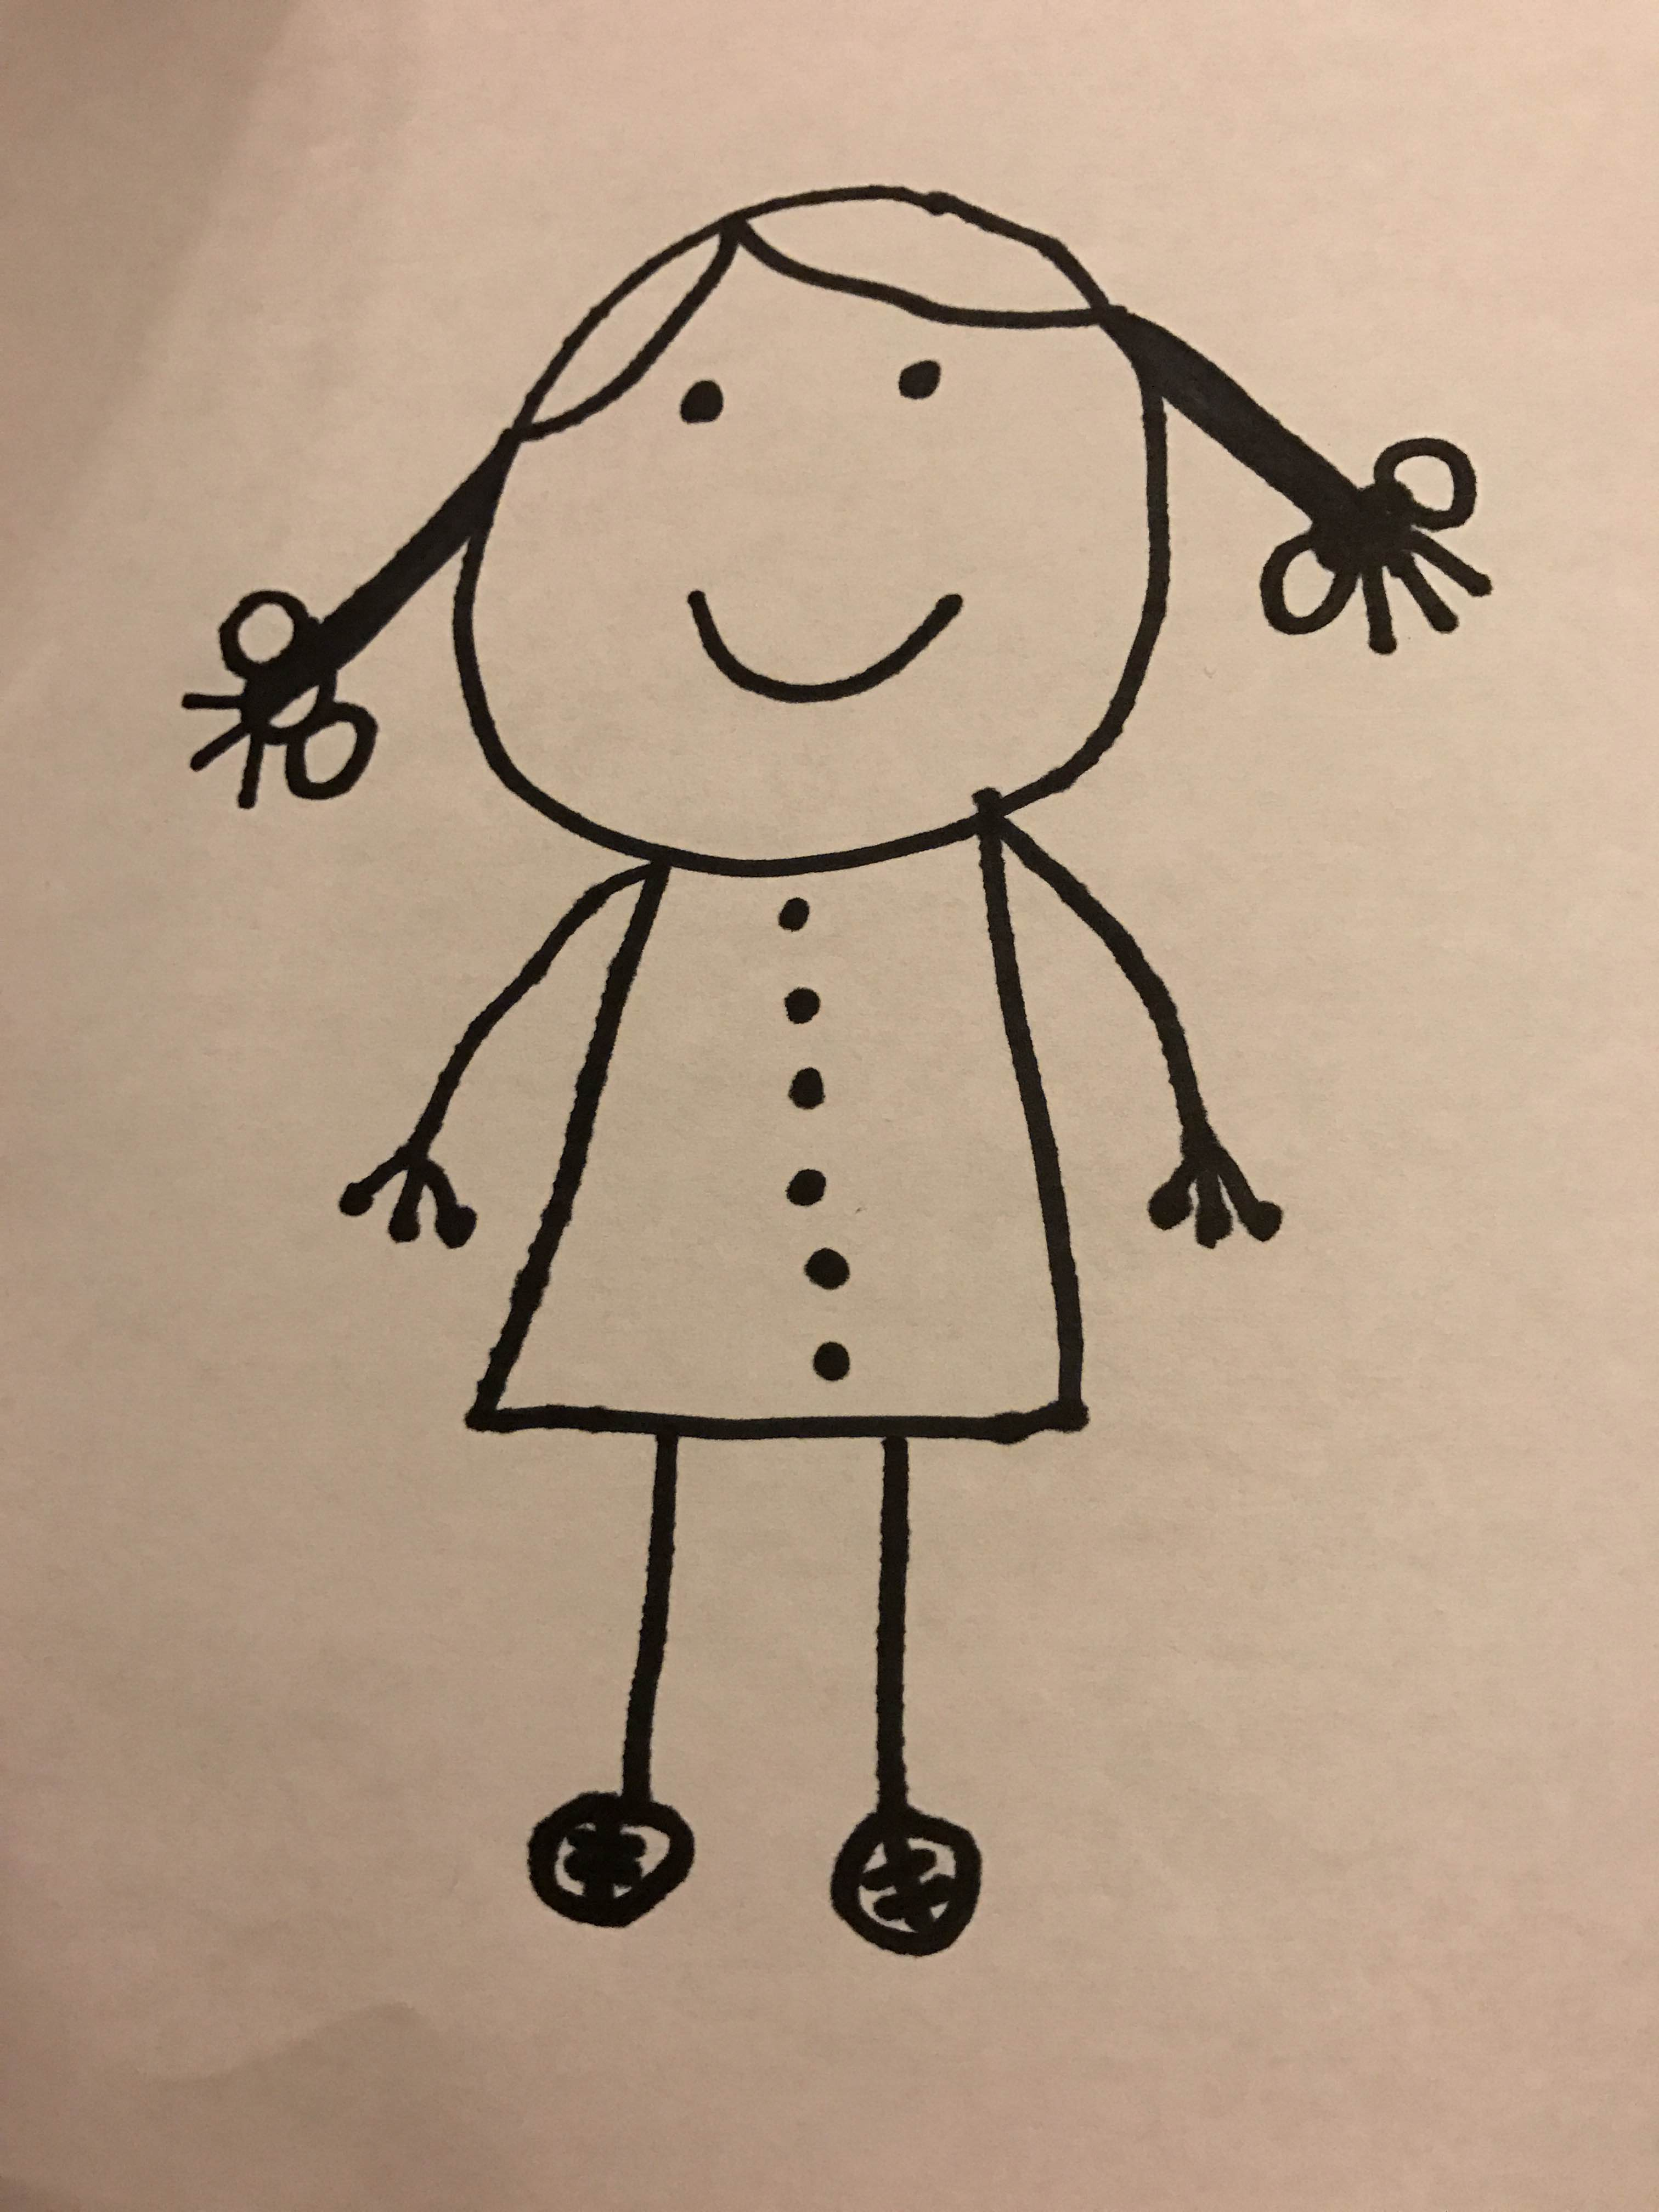
Product is my external imagination
(Exploratory) Tester
Notes:
One of the things I approach these things differently than most programmers, (I still identify as a programmer, and a polyglot programmer myself, been writing code in 14 languages) is that even though I can read the code, write the code, I spend most of my time with the product, the solution, the application. I look at the product as if it was my external imagination. It speaks to me. It whispers to me when I look at it. It tells me, like, when I look at a button: ”You want to click here, right?”. And I click, something happens.
When I look at an API, it is the exact same thing. I see a field, or I see two APIs and it wispers to me ”You’d want to chain calls to these APIs with these particular fields”. Then again, magic happens and things of unexpected nature may come out.
I also find that people like myself, who identify as testers, tend to be the external imagination for those people who don’t identify as testers. Sometimes when I sit next to my developers, they look at me being all quiet and say ”You’d want me to click here, right?”. They do, and then they find the bug they could have found all by themselves, should they just try that without being inspired by an external imagination.

Slide 10
Never be bored.
Heuristics

Slide 11
In the beginning, you know the least.
Heuristics
Notes:
Documenting vs. Discovering

Slide 12
Poke it until it pops
Heuristics
Variable recognition and persistency heuristics from Alexandra Schladebeck

Slide 13
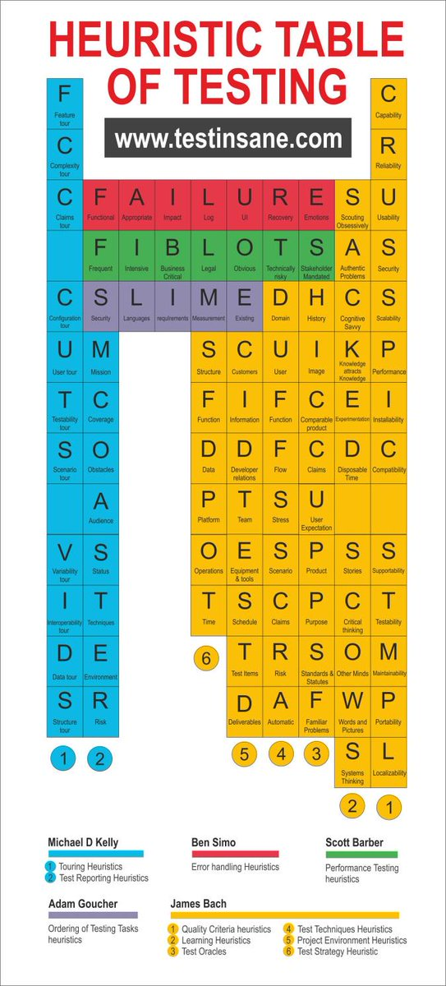

Slide 14
Structure Function Data Platform Operations Time

Slide 15
Approvers do
I LEARNED ABOUT FUNCTIONS
Formatting
Sorting
File Extensions
Scrubbing (removing common inconsistencies)
Serialization(saving to a file)
Mocking
Proxying
Rendering
Execution (e.g. retrieve the URL)
Aggregating test cases
File naming
PRINCIPLE: ”Every time you handle this type of object, you do these things to it.”

Slide 16
Reporters do
I LEARNED ABOUT FUNCTIONS
Waiting
Scrubbing (removing common inconsistencies)
Execution
Launching
Serialization
Decompilation
Chain of responsibility
Creating Approved file
Environmental awareness

Slide 17
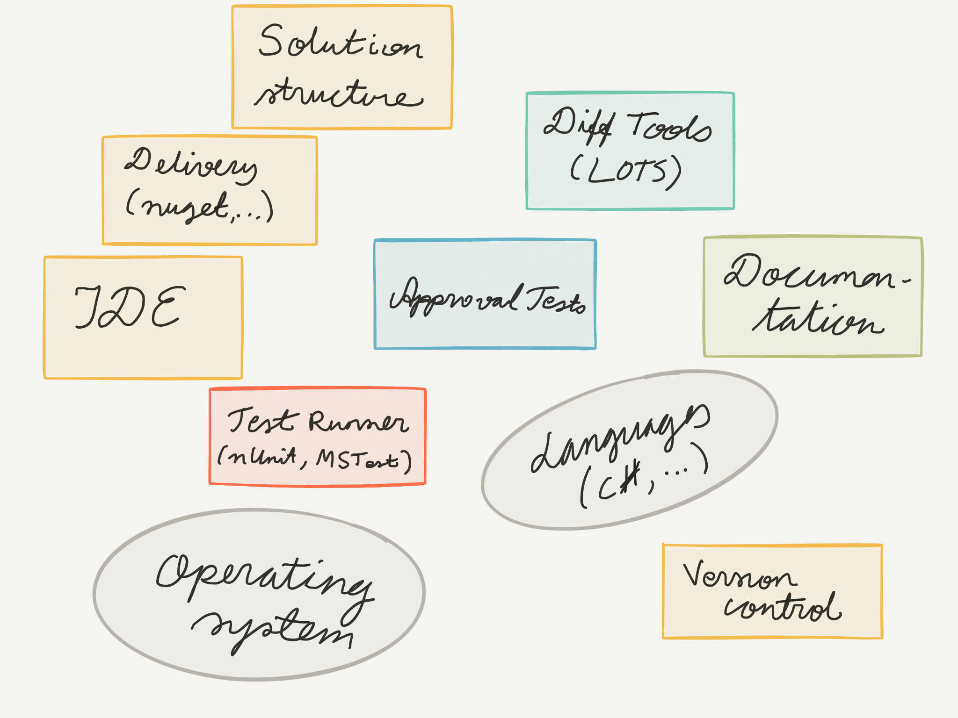
I LEARNED ABOUT THE ENVIRONMENT

Slide 18
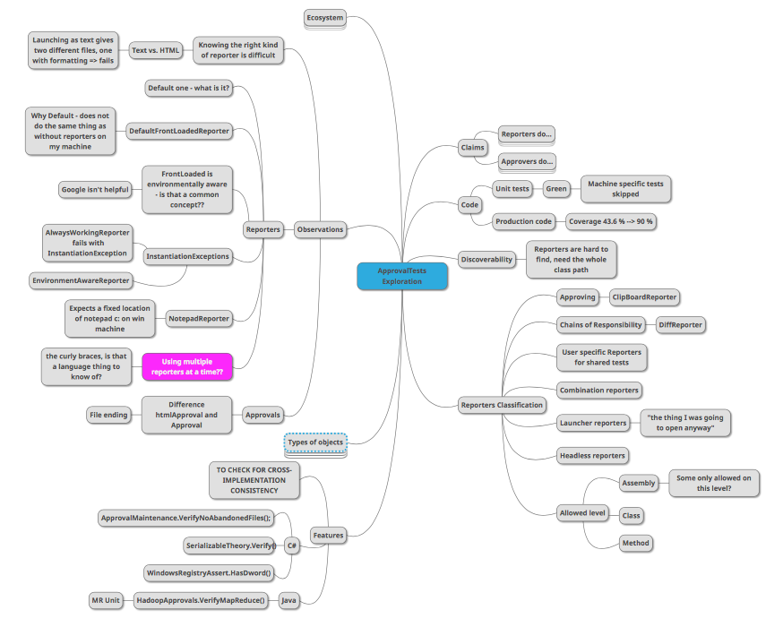

Slide 19
Code doing what it’s supposed to.
Product doing what it would need to.
Product doing only what it is supposed to do.
Notes:
I call these basic illusions, because they are about the stuff we need to find in projects related directly to the quality (or lack of thereof) of our systems.

Slide 20
Bonus Illusion: Test Coverage
Testing being done.
Notes:
Telemetry

Slide 21
Three Other Illusions
The Ideas Leading into Code
Notes:
In addition to these three basic illusions that I break regularly, pretty much every day, counting how many times I run into these ever single day. There’s also a different set of illusions that I find that as someone who is part of the teams I also get to break a lot.

Slide 22
Illusion type VI: Business model driving the selection of right focus.
Notes:
We think we are implementing the right features, the ones that get us paid. Esp. in previous organization, being able to suggest a test case of making a contract with pay up front before starting to deliver would be possible. When that contract was proposed, to learn there was never any extra money coming in.
Full of assumptions that need to be tested. Experiment design is a match for a testers skills!
Beer game

Slide 23
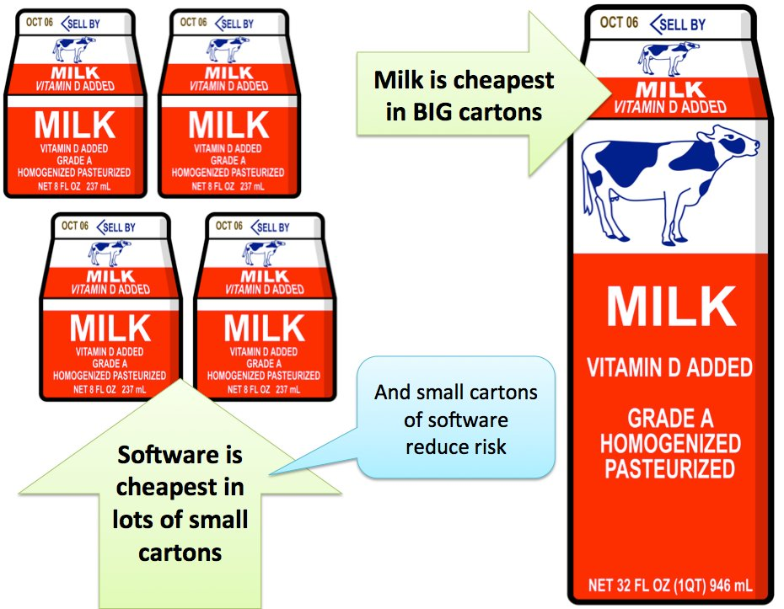
Insight and illustration from Allan Kelly, @allankellynet

Slide 24
Illusion type V: People having skills to deliver well.
Notes:
We like thinking we know the things we know. But the more I learn, the more I realize there is to know.
Remembering the Helsinki example, consciously keeping track of 40 things at a time. We may not always remember to habitually use all the great skills we have and put them into use.
Not everyone *can* test, but everyone can learn to test. Just like everyone can learn to program!
Holding space for great skilled testing.
Positive feedback on concrete things.

Slide 25

Notes:
But not always…

Slide 26
Illusion type IV: Process being able to deliver with change in mind.
Notes:
Way of working we have now would give us ability to work in effective manner in long term doing maintenance, addressing things none of us can foresee.
One example of this is having a product owner in the room, sitting with us all, the developers. I started noticing that it made our communication really weird. Everyone of us would talk to the product owner, and then we’d stop. We did not talk to each other, but just the PO. We had an illusion that the product owner was the key person instead of our team mutual understanding. I had the product owner moved out of the room, going to his manager, and it improved things a lot. These kind of small tweaks to process happen a lot of times just as you identify them and do something.
Missing practices, not suboptimizing to testing
Example PO in the room

Slide 27
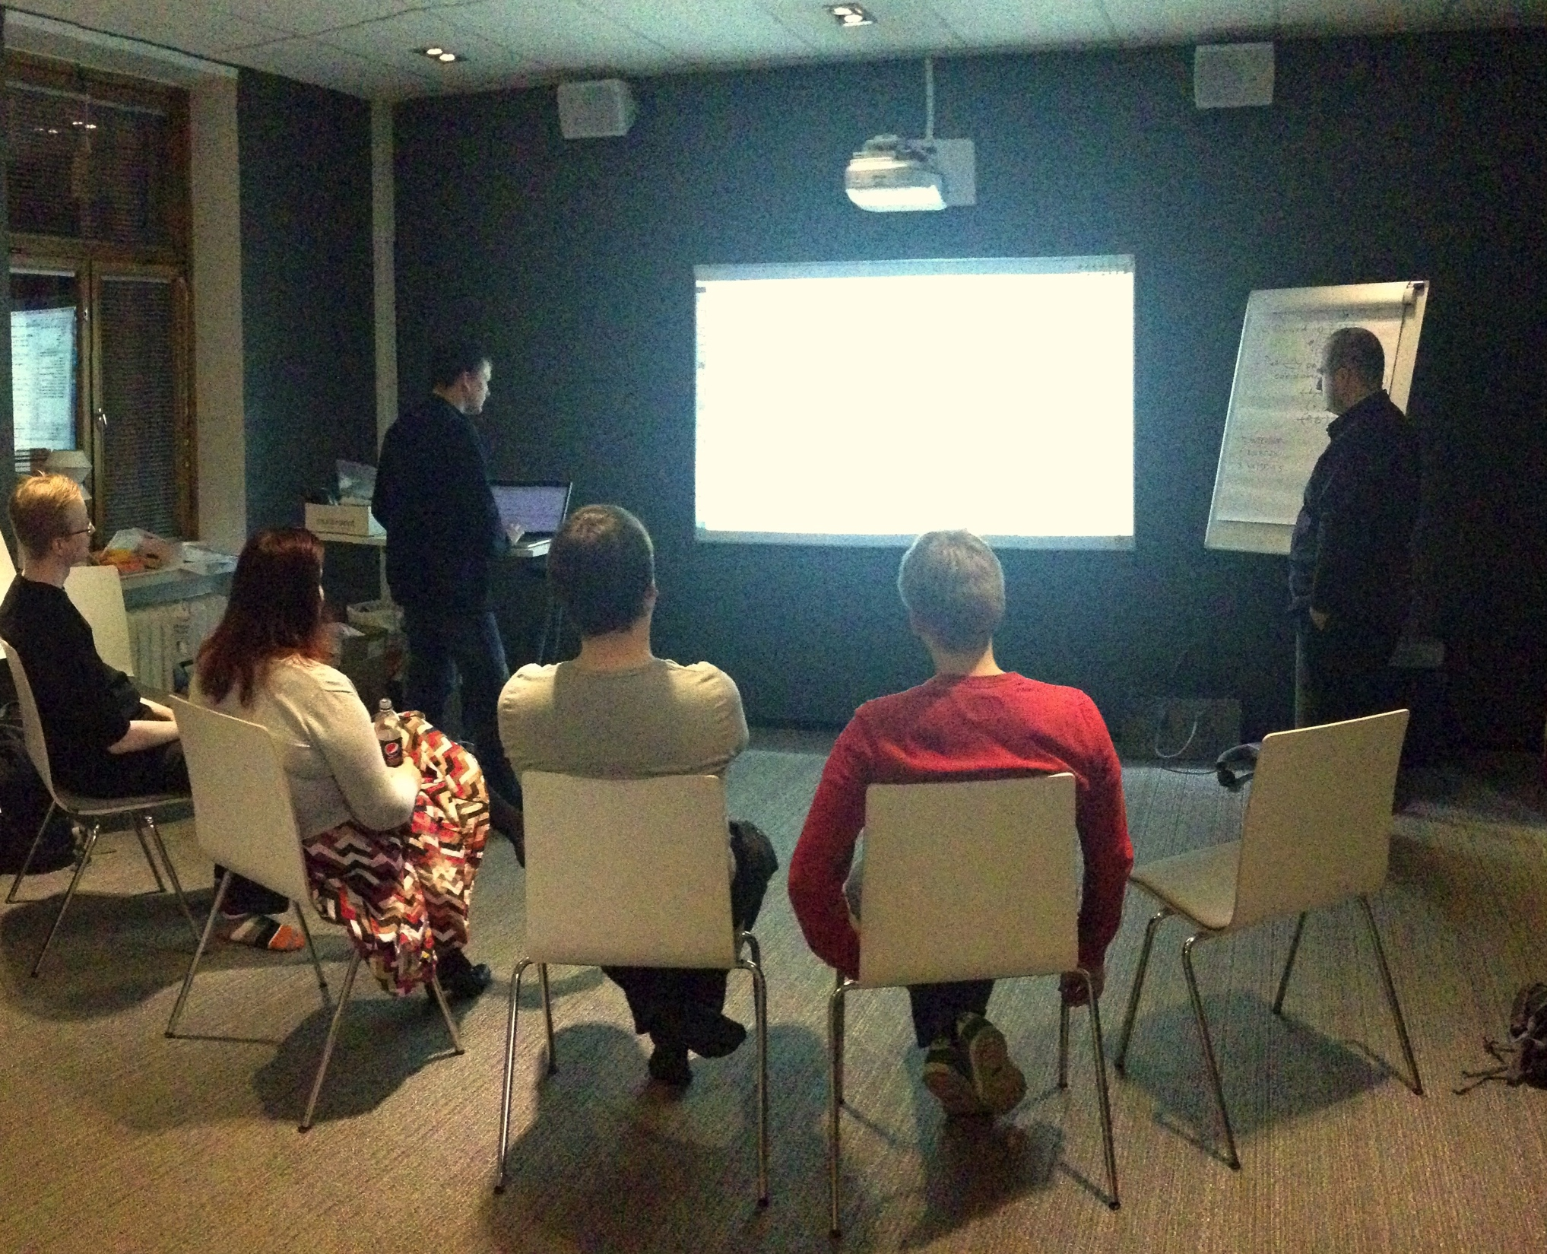
Cognitive Dissonance
Notes:
Try things to see if they work. No product owner.

Slide 28
Continuous Delivery
No Jira
No Estimates
No Product Owner
No Projects
No Scrum

Slide 29
Learning
Superpower and core of exploring

Slide 30
Learning
I know more than you do!
There is still so much more I can learn from you
I know everything you do!
You have nothing left to teach me
vs.
Linear Viewpoint
Reality

Slide 31
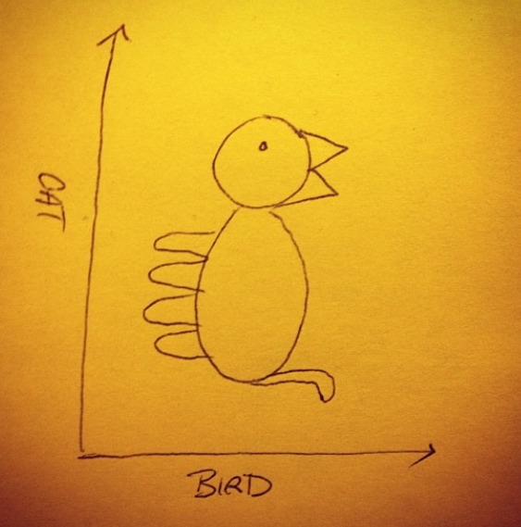
Things Can Look Different from Different Perspectives
Notes:
When you look at something, look at it with open mind, open eyes and be ready to see more.
You can see this image is obviously a cat but it is also a bird.If you look at it, giving it a little more time, maybe you see also other things there.
Geometric shapes, some more symmetrical. Lines have width, but there is also empty space.
Difference with me looking at an application and my dev colleagues looking at an application is that I look at it hundred times and they look at it once.
Point of this slide: DIVERSITY brings good results: people who choose to love testing tend to be different from those who choose to love checking and development
Not every team has the most skilled developers but they can still have diverse teams delivering excellent results

Slide 32
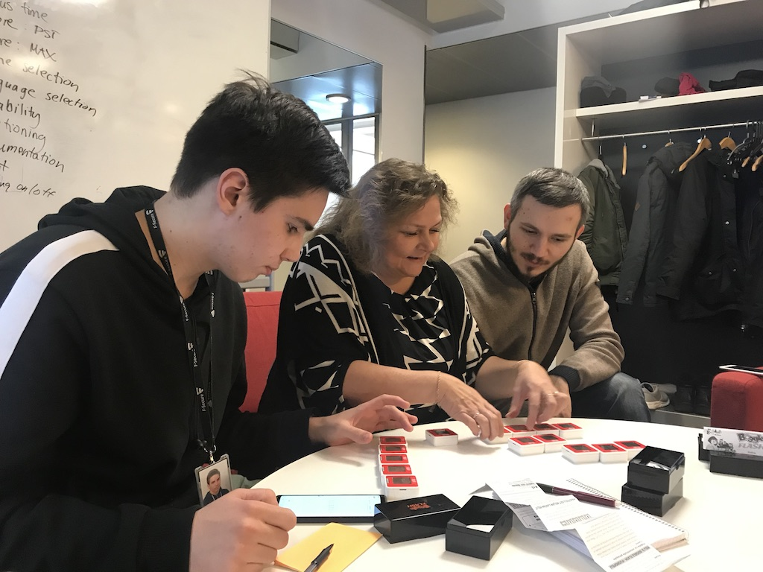
Notes:
Learning about learning.

Slide 33
Lesson 1. Testing is not using the system. You need to be more driven to information and understanding. More intentional.

Slide 34
Lesson 2. Intent is not enough. Serendipity happens through elements of play and making unplanned connections. Awareness of what you know and how you know it becomes essential.

Slide 35
Lesson 3. You are in control. When system gives you a hard constraint, there are still ways you can work through that constraint. If you can simplify or isolate, do that. Complex can happen later.
Notes:
Testing it one way is not enough!

Slide 36
Lesson 4. Testability. When something is hard to do, remember there’s a developer somewhere who needs to share the pain to build smarter next time.
Notes:
Testing it one way is not enough!

Slide 37
Lesson 5. You got tools. Find them. You pull in what you need, not rely on just what you’re given.
Notes:
Testing it one way is not enough!

Slide 38
Lesson 6. Yes, that automation of permutations integrated with vocabulary would come in handy. What you can’t find but want, you can build.
Notes:
Testing it one way is not enough!

Slide 39
Lesson 7. It really does not calculate scores right. But does that matter - what is quality for this game? What creates emotions relevant enough to impact user’s behavior?
Notes:
Testing it one way is not enough!

Slide 40
Serendipity and Perseverance
Notes:
The main thing I do differently is I stay around longer. I try to find more things to do, and it enables me to run into things by accident. I never really imagined that finding an IPv6 address from command line output would be different than what I found googling, yet it expised me to things I did not run into otherwise.

Slide 41
The more I practice, the luckier I get
– Arnold Palmer
Notes:
On serendipity this is great. The more bugs I find, the more perspectives I bring, more illusions I have a chance of breaking.

Slide 42
It’s not that I’m so smart, I just stay with the problems longer. – Albert Einstein

Slide 43
Phrase and illustration by Liz Keogh @lunivore
Deliberate Discovery Skills
1 2
3
4 5
1 2
:
4 5
Notes:
Brainspace is limited and the focus on breaking and discovering information enables bringing in perspectives that otherwise are easy to miss.
Discovering information. Discovering lessons we learned from an experience.
Documenting vs. discovering.

